Slide 1
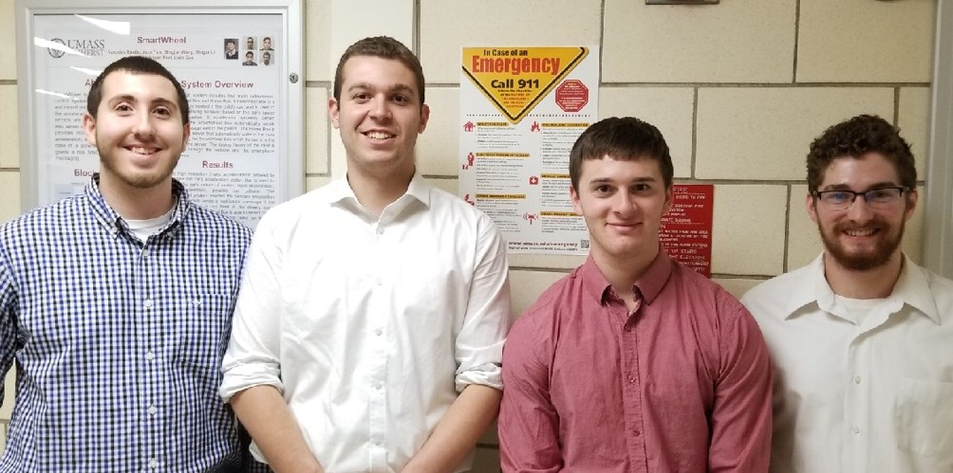
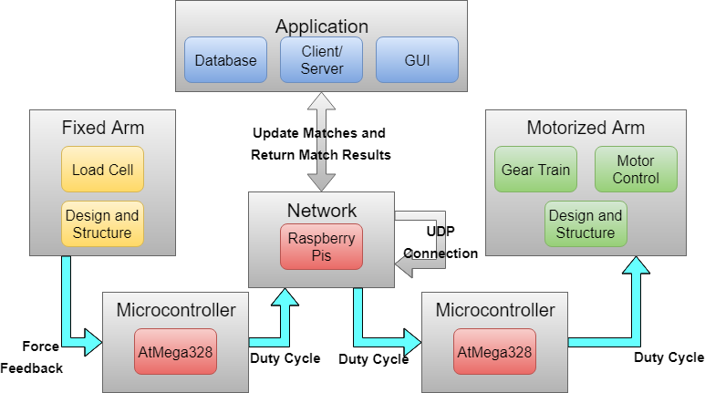
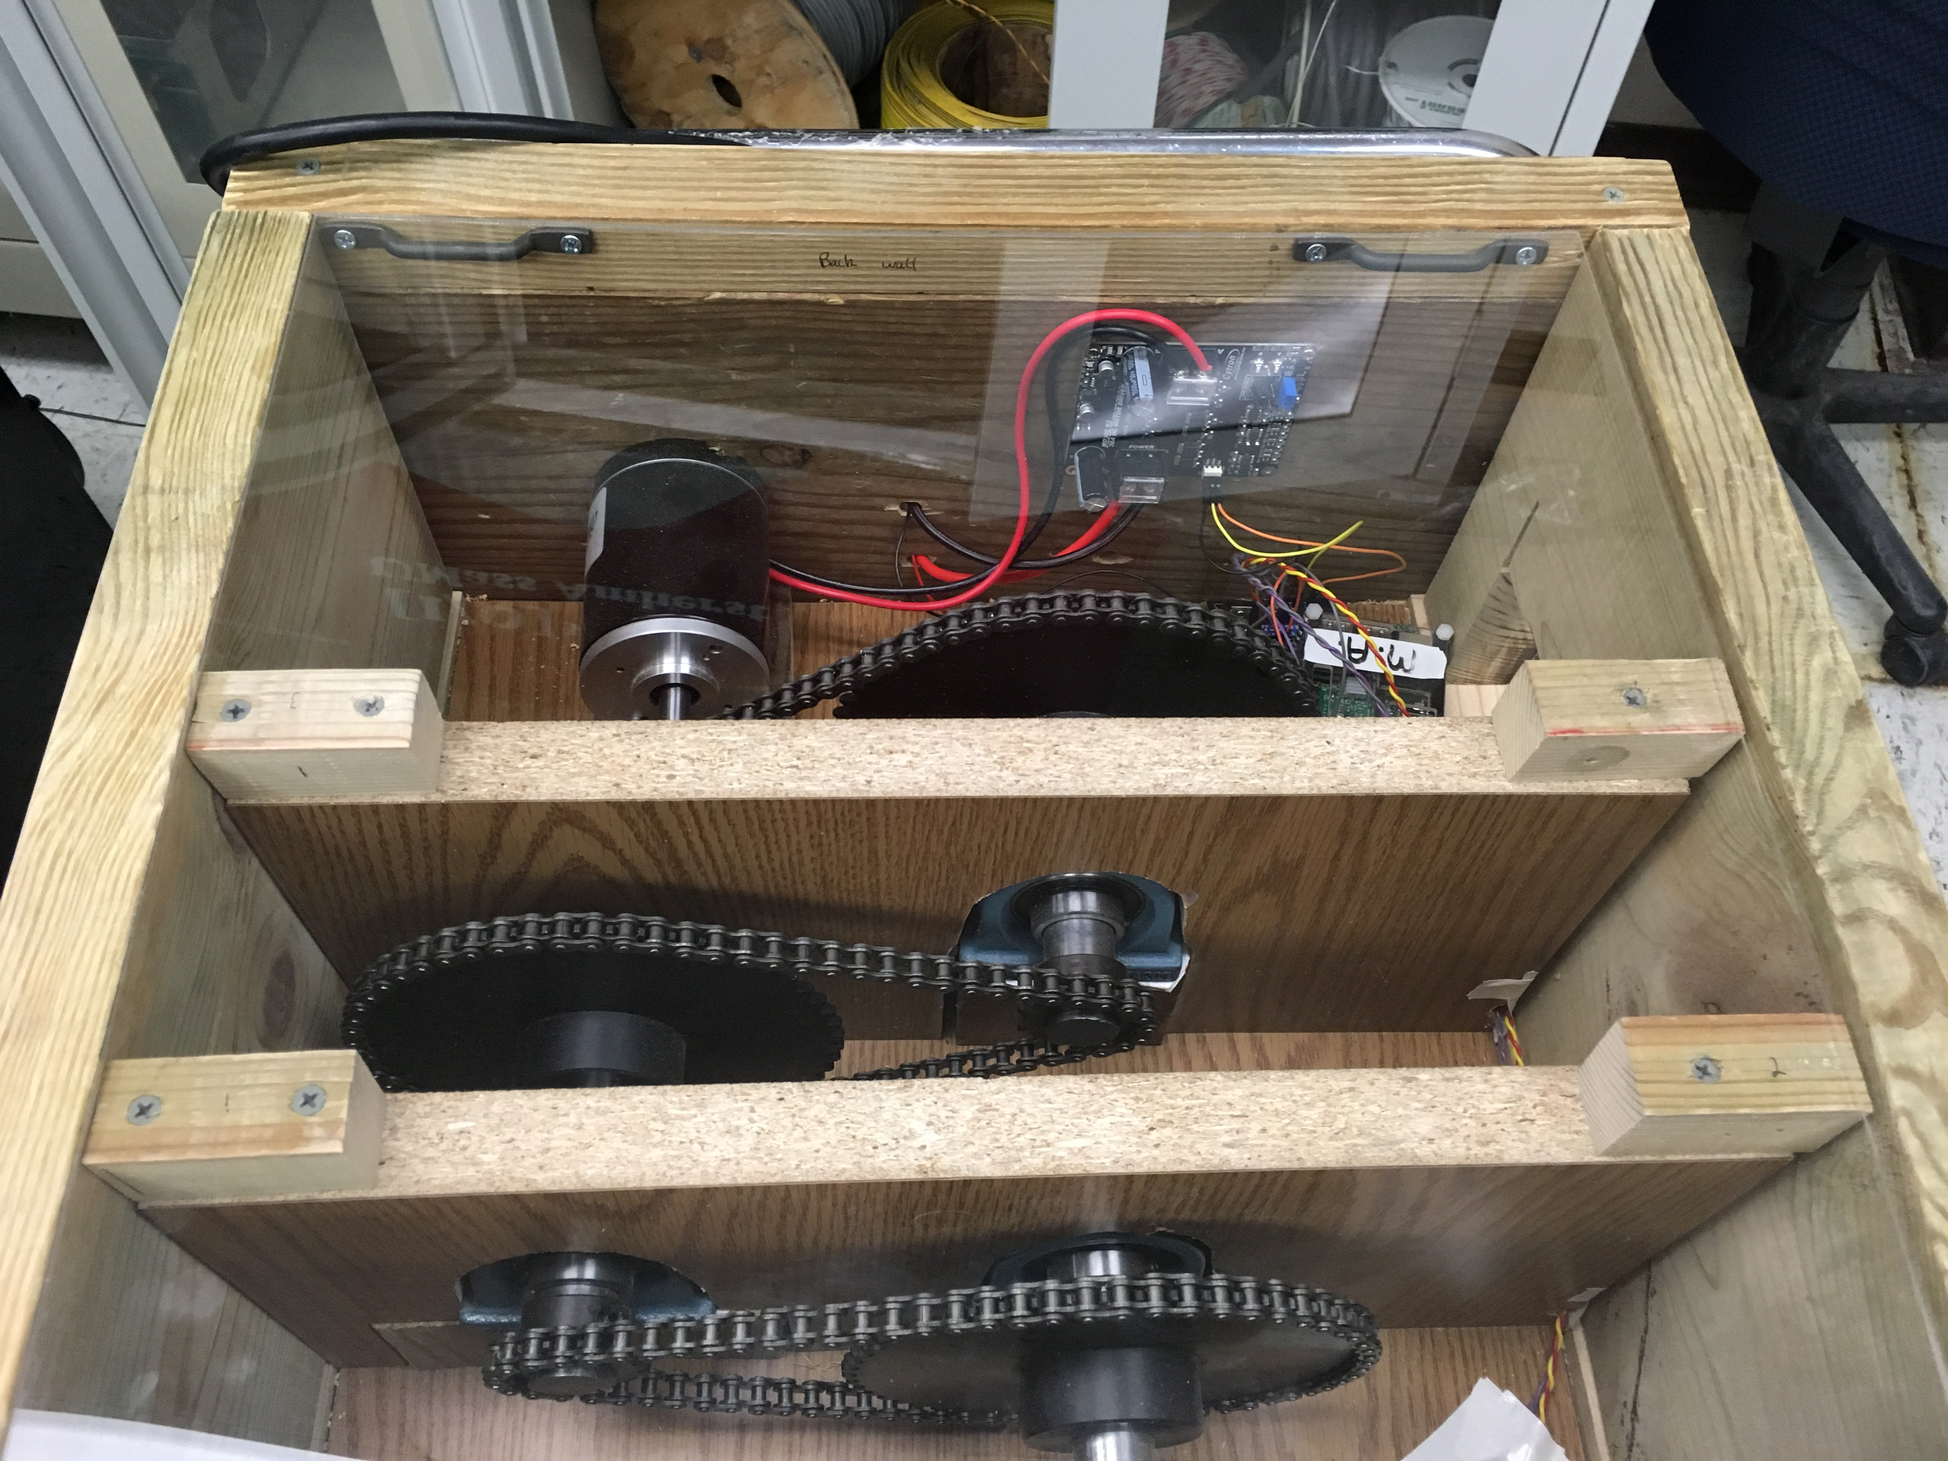
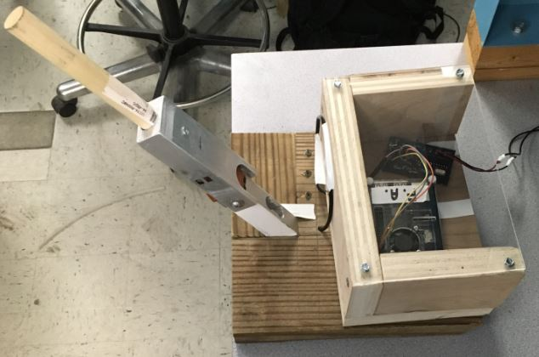
R.A.W. Remote Arm Wrestling
Tyler Costa, Steve Lucey, Zach Matthews, Steve McGrath
Faculty Advisor: Prof. Michael Zink
Abstract
Data Analysis
We introduce R.A.W. (Remote Arm Wrestling), a real-time system that emulates arm wrestling across a low latency network. This system provides the user with the same fun and excitement of an in-person arm wrestling match, except the game will be played over a distance between a user and a weighted pulley system. There will be one robotic arm powered by a motor, which drives a series of gears, and is attached to a pulley. There will also be a fixed are, with a forearm that will have strain gauges on it to find the force applied by the user. The motorized arm, will replicate the force being applied by the user to the fixed arm. There is also a phone application that allows a user to make a profile and join/schedule matches. The arms will query the database to find any matches for that day and allow the users to join their match.
In order to properly drive the motor with the correct replicated force we needed to test and map out several relationships.
First we applied different loads to the fixed arm to get an initial correlation between pounds and voltage difference readings from the load cell.
This relationship can be seen on the left.
From here, we needed to further map this relationship to a duty cycle.
We converted pounds to force using the equation: Force = Pounds * 4.48.
System Block Diagram
Graph 1. Voltage Difference vs Pounds
Next we convert force to torque using the equation: Torque = Force * .235 m (forearm length).
The final part of accurately relating the users force to a duty cycle for the motor, is relating this torque to a current and then this current to the duty cycle needed.
The first graph to the right, shows the relationship between current and torque for the motor we used. This is the key equation in relating the initial loads to the currents needed for the motor.
This final graph shows the relationship from that current to the duty cycle that would then drive the motor.
Graph 2. Torque vs. Current
Motorized Arm
The motorized arm consists of a 24V brushed DC motor connected to a train gear ratio of 1:77.
The microcontroller outputs a PWM (Pulse Width Modulation) and direction to the motor driver.
Each set of gears is connected through a rotating bearing held down by a support wall.
Graph 3. Current vs Duty Cycle
Results
Figure 1. Motorized Arm
We believe Remote Arm Wrestling to be possible if fully implemented.
The two major restrictions would be network delay and motor resistance.
A low latency network connection is required to allow a match, although the amount of data transferred is small. Each data transfer is only one packet, which is sent somewhat frequently, thus allowing for a dropped packet if need be.
With a motor, there is an inherent resistance that makes it hard to move. To accommodate this, the motor can provide assistance in the direction needed, depending on the forces in play.
The entire system is encased by four walls and a clear cover.
Fixed Arm
The fixed arm is the length of an average persons forearm (.3 meters).
The user applies force to the forearm which triggers the 50 kg load cell attached to the base.
Acknowledgement
Figure 2. Fixed Arm
Special thanks to Professor Michael Zink. Thank you to professors Christopher Hollot, Baird Soules, Weibo Gong, and Russel Tessier. Thank you to Professor Frank Sup for help with the mechanical design. Also thanks to Fran Caron.
The load cell produces a voltage differential which is used to create a PWM signal (duty cycle) to drive the motorized arm.
Department of Electrical and Computer Engineering
ECE 415/ECE 416 – SENIOR DESIGN PROJECT 2018
College of Engineering - University of Massachusetts Amherst
SDP18

Slide 2
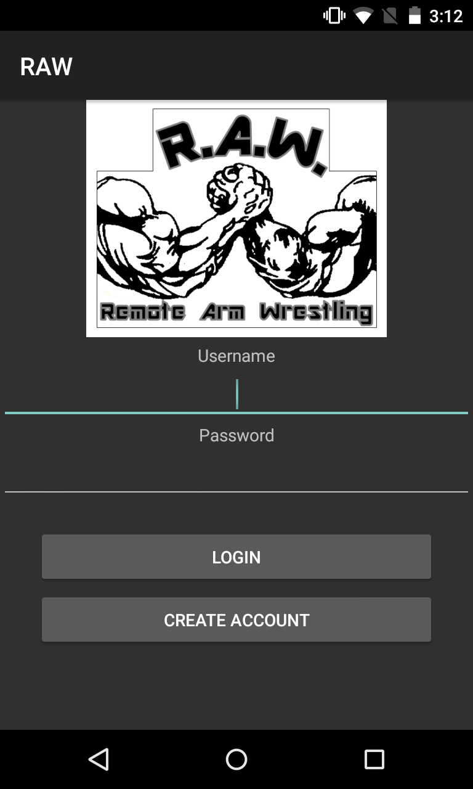
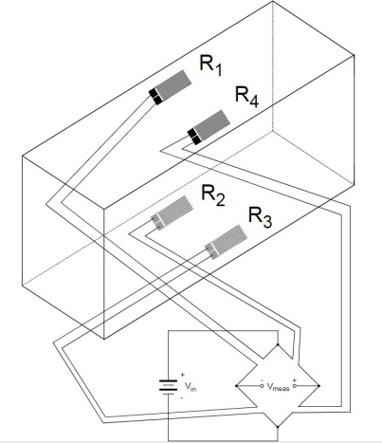
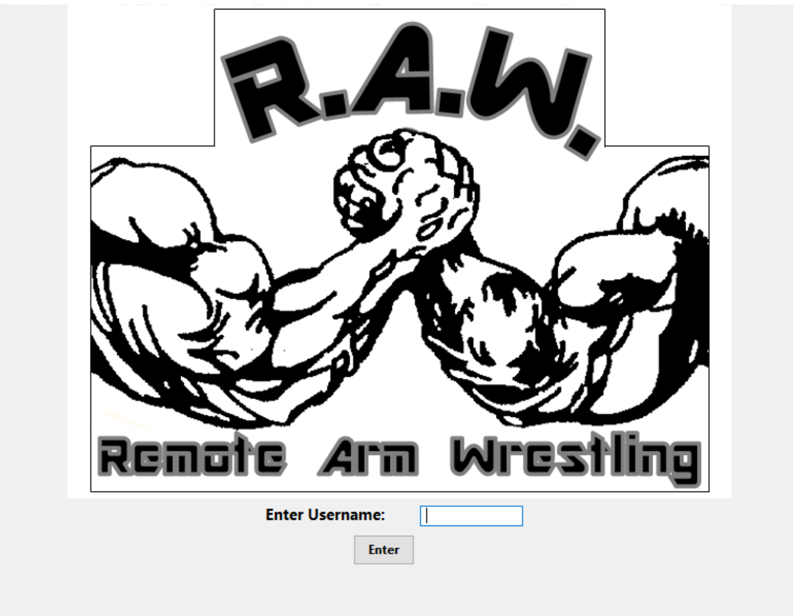
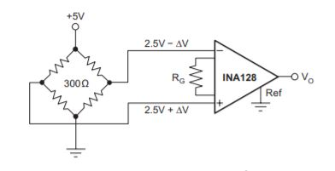
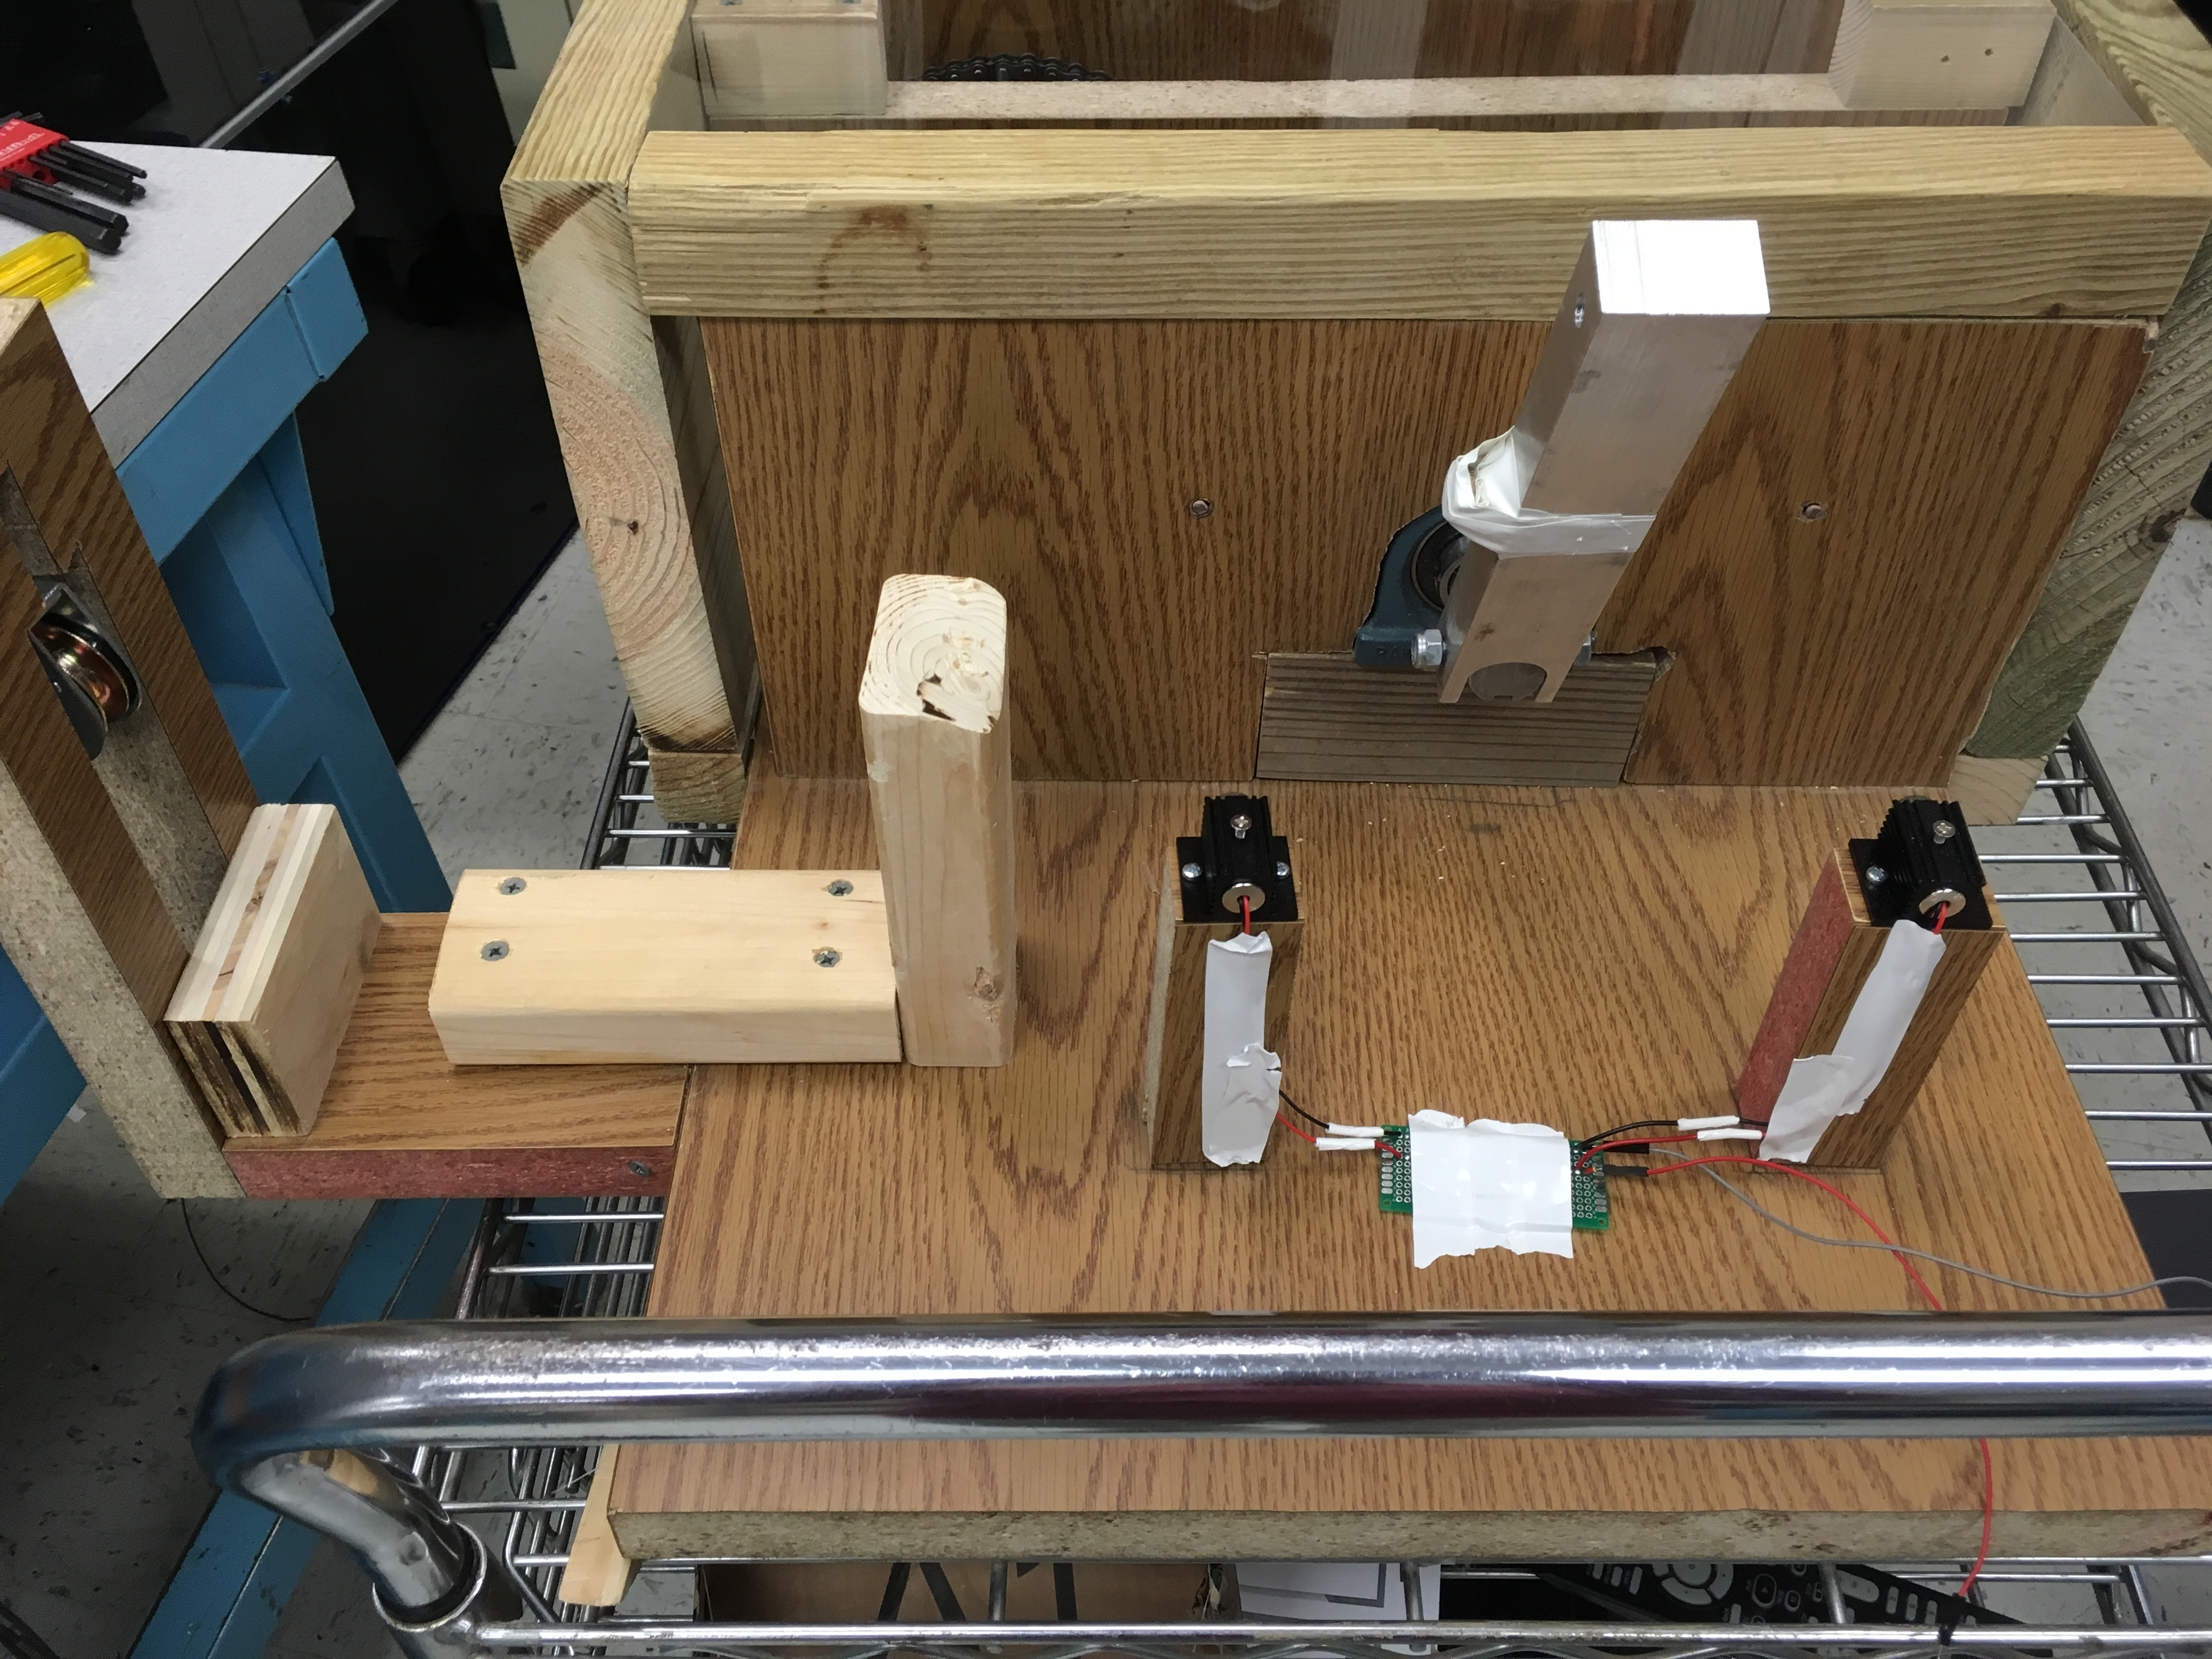
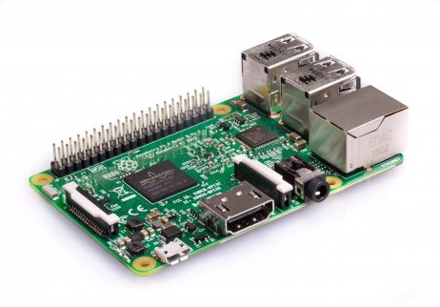
System Specifications
Application
Requirements | Specifications
Forearm length must be the average length of a human forearm | Forearm length is about .3 meters
Provide Real-time feedback | Feedback will be < 100 ms
Arm moves similar to a human arm | Gears and Motor must not have sudden movements
Arm must be able to withstand forces applied | Stable and Secure to forces up to 100 PWM sent to motor
All parts must enclosed | Clear encasement made so no gears are exposed
Android application that allows for the creation of an account and creation of matches.
User can follow friends or other users and also get followed by other users.
User gets placed into a weight class to allow for more competitive matches.
Stores result of each match so user can see their win/loss record.
All data is stored and updated to a MS SQL Server hosted by AWS.
Load Cell
The 50kg load cell is comprised of strain gauges formed in a Full Wheatstone Bridge Configuration (Figure 1).
The strain gauges work as the variable resistors in a way that the change in stress on the forearm will change the resistance of the strain gauges.
This will vary the output voltage differential and produce a result in millivolts which we amplified using a INA12BP instrumentation amplifier (Figure 2).
Figure 6. Application Login Screen
Match Login
This screen allows the user to sign into their match on the arm they chose.
GUI is connected to an XMLRPC client/server which queries the database for the users match.
This GUI will display a win or loss upon match ending.
The result of the match will also be updated to the database.
Figure 3. Full Wheatstone Bridge configuration
The resultant voltage differential is the value that is input into the ATmega328p and turned into a duty cycle.
This duty cycle is then transferred over the network connections established by the Raspberry Pis.
Figure 4. INA128P instrumentation amplifier connected to Full Wheatstone Bridge
Figure 7. Match Login Screen on Raspberry Pi
Win/Loss Signal
Networking
Two laser pointers on both sides of the arm are in place to indicate a win or a loss for the match.
Each laser pointer is pointing at a photoresistor which is connected to an analog input on the microcontroller.
There are two essential network communication lines that we need for our project.
First, is the direct connection between the two arms through a wireless ad hoc network.
This connection carries the duty cycle numbers between the two arms.
Figure 5. Laser Pointer Configuration
Figure 8. Raspberry Pi 3
Once the arm breaks the plane of one of the lasers, it will then drop the photoresistor reading below its threshold and return a win or a loss to the Raspberry Pi.
Cost
This connection must be responsive to keep the arms in sync, as we aim for a delay of 100ms or less.
In order to test this delay we would have needed two motorized arms which we did not have.
Second, is the connection to the Server which communicates with the Database.
This connection checks the Database for valid matches to allow users to start their scheduled matches.
It also provides the Database with the results of the match upon conclusion.
Latency is not an issue with this connection, as it is only needed before and after the match takes place.
The connection to the server is not part of the ad hoc network that is established between the two Raspberry Pis, but it is an additional network connection.
Development
Production
Part | Price
PCB w/ AtMega | 50
Motor | 79
Driver/Pow. Sup. | 81
Load Cell | 14
Gears and Chain | 124
Drive Shaft | 27
Bearings | 28
Key Lock | 4
Forearm | 46
Pully | 6
RPi 3 | 35
Total | 494
Part | Price
PCB w/ AtMega | 7
Motor | 45
Drive/ Pow. Sup. | 43
Load Cell | 10
Gears and Chain | 70
Drive Shaft | 15
Bearing | 18
Key Lock | 2
Forearm | 34
Pully | 3
RPi 3 | 20
Total | 267
Database
AWS instance of a Microsoft SQL Server database.
Has tables that consist of Profiles, User Connections and Matches.
Queried by both the application and the match login.
Queries from the application consist of inserts and updates.
Queries from the match login are selects and updates.
Primary key is based on the username that the user chooses when they create an account.

